Slide 1
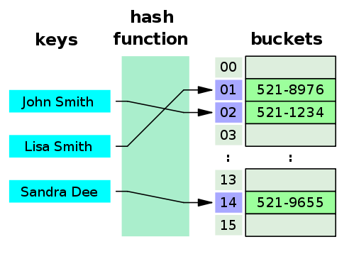
Hash table

Slide 2
Hashing – principle
Data is stored in an array
The index is calculated based on a key.
index = hash-function (key)
Insert
put(key, value)
”Search”
get (key)
The hash-function must
return an integer (index < size of table)
be easy to calculate (why?)
Minimize the number of collisions
distribute data elements evenly across the table (why?)

Slide 3
Hash function (ex):
key value modulo 11
(11 = size of table)
ex:
Key value: 13
hash (13) => 13 mod 11 => 2
0 | 11
1 | 1
2 | 13
3
4
5
6
7
8 | 30
9
10 | 10

Slide 4
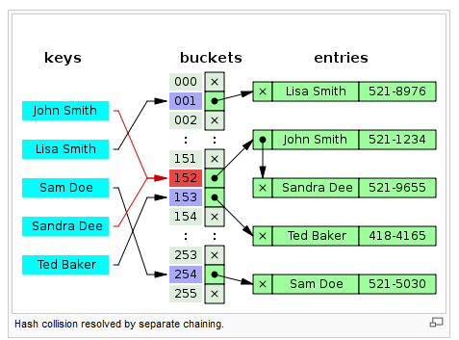
Collisions, chaining

Slide 5
Efficiency and hash table
Insert, delete and search is (nearly) independent of the number of elements (n)
O(1)
Load factor
Table size << number of possible different key values
Preferred when you require fast
search
Insert
but not fast
Iterate sorted
Location of max /min

Slide 6
Java Collections Framework
Include
interfaces
implementations
methods, that manipulates collections
Interfaces:
Collection // a group of elements
Set // no dublicates (~ mathematical set concept)
List // ordered Collection, each element has a position
Queue // ordered Collection with special operations (ex: FIFO)
SortedSet // ordered by the natural ordering of the elements // (Comparable)
Map // ~ table of (key,value)- pairs. No dublicate keys
SortedMap // ordered according to the natural order of the key //(Comparable)

Slide 7
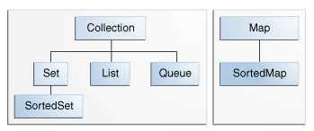
Interfaces in JCF

Slide 8
Implementations of interfaces
General-purpose Implementations
Interfaces | Hash table Implementations | Resizable array Implementations | Tree Implementations | Linked list Implementations | Hash table + Linked list Implementations
Set | HashSet |  | TreeSet |  | LinkedHashSet
List |  | ArrayList |  | LinkedList
Queue |  |  |  | (LinkedList)
Map | HashMap |  | TreeMap |  | LinkedHashMap
(SortedSet and Sorted Map)

Slide 9
Methods (algorithms)
The Collections class
sorting
shuffling
rutine data manipulation (List)
searching

Slide 10
Efficiency of data structure
 | array Eg. int[] | ArrayList | Linked list | Hash map | BST (Binary search tree
insert first insert last insert middle
erase first erase last erase middle
find
iteration
Sorted iteration
Notes:
1: array
2: linked
3: hash
4. Array eller linked
5. Binært søgetræ

